Slide 1
Teaching program

Slide 2
The materials for this course have been designed so that they may be used in sequence, or allow teachers to use only the resources that fit with their own teaching programs.
Each resource is profiled on the following pages, identifying what it can be used for and possible formative activities.

Slide 3
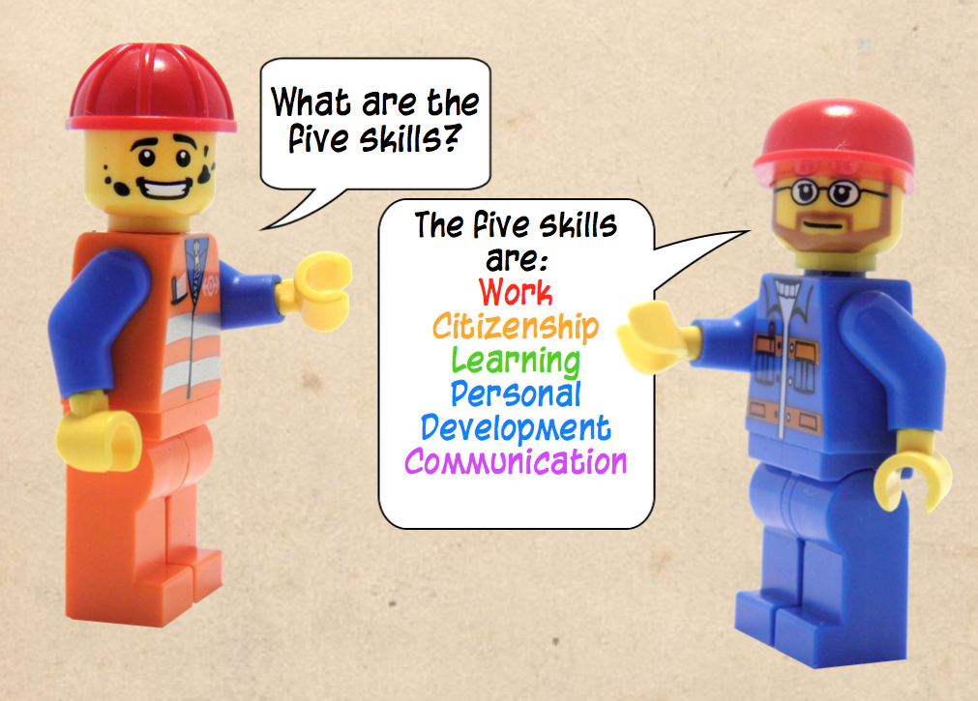
Features
Colour coding:
Each of the five skills is identified by a different colour in text and headings.

Slide 4
Features
Contextualisation:
Course materials were designed for students in remote communities.
Images and stories incorporate aspects of NT community life.

Slide 5
Features
Texts come in multimodal format:
Course materials are mostly a combination of audio, visuals and text. Students are able to navigate through presentations at their own pace and review content they have difficulty with.

Slide 6
Features
Personalisation of content:
Characters are used to exemplify concepts and provide models. Mike is the primary character. He is used in all aspects of the course, with supporting characters Jodie and Mark providing additional examples where necessary.

Slide 7
Features
Storytelling:
The importance of storytelling as communication in Indigenous communities has been featured in course materials by:
Providing digital storytelling tutorials.
Sample activities are, where possible, presented as stories.
Content is unpacked in the form of stories.

Slide 8
Features
Multimodal activity formats
Materials support students to demonstrate learning in a multimodal format by providing:
Tutorials showing teachers and students how to record audio, edit video, annotate PDFs and create photo stories.
Sample activity items in several formats, particularly in the Developing Goals section, giving teachers samples to unpack for students.
Activities are written to allow students to use multimodal or written formats.

Slide 9
Features
Non-linear content structure:
Where possible content is presented in a non-linear format, allowing students and teachers to pick the material they would like to access.
This allows users to select content that is relevant to their context/interests and disregard other content without impacting on understanding.
You don’t need to look at every option in a non-linear document to cover content with students. Sometimes this would even be counterproductive. Students will be exposed to too many options and start getting ‘lost’. Materials are explored with the intention that students can investigate some of the options and still gain a good understanding of concepts covered.

Slide 10
Features
Formative exercises:
Some of the resources also have a list of formative exercises that teachers can use in this program. You do not need to do all, or any of the formative exercises. You could also use other formative exercises that you think are more appropriate for your students.

Slide 11
Understanding the five SKILLS

Slide 12
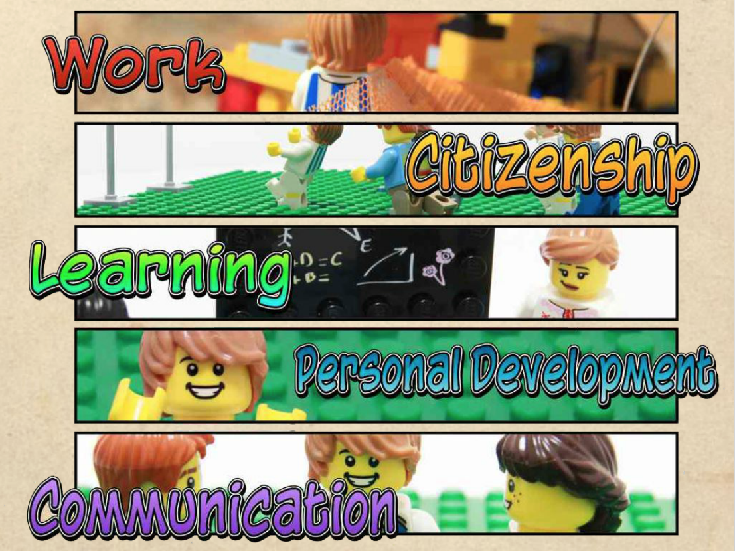
The five skills
Purpose: To introduce the five skills to students.
Non linear format: Content covers a definition of the skills and an illustrative example of each. Users can choose which skill to explore, whether they want to look at just the definition or the definition and then example.
Use: Can be used to introduce the five skills to students all at once, or one skill at a time. Can focus on exploring all of the materials about one skill and then come back to this document and focus on the next skill.

Slide 13
The five skills (cont.)
Purpose: To introduce the five skills to students.
Formative activities:
Can skip the provided examples and get students to come up with their own (verbal? In groups?) and present to class.
Identify examples as a class and list on board.
Identify which parts of a typical school day could be linked to a skill (learning=school work, work=teaching, cleaning etc).

Slide 14
Activities
Formative
Summative
Teachers can choose to have students complete any or none of the suggested formative exercises. They can develop their own or simply focus only on the summative activity item.
Students explain their understanding of the five skills and provide examples for each from their life experience or from family/friends/their community.

Slide 15
Communication

Slide 16
Is this a form of communication?
Purpose: To highlight the many different instances of communication in the community. An introductory presentation, like this one, has been created for each of the capabilities.
Non linear format: Content is navigated from the large grid of images. Hovering over the images should then show you a ‘rollover’ which reveals a text description of each. You don’t need to look at every branch included. This would probably be quite time consuming/boring
Use: Can be used to introduce communication as a skill in more depth or as a model of explaining what the skills are, as suggested in the first activity item.

Slide 17
Is this a form of communication? (cont.)
Purpose: To highlight the many different instances of communication in the community. An introductory presentation, like this one, has been created for each of the capabilities.
Formative activities:
Students (individually or in groups) take one of each of the examples shown in the document and then expand on it, using their own experiences to illustrate.
Navigate from the main choice grid to the question (Is ___ a form of communication?) Class can discuss whether they think it is a form of communication and explain why. The move to answer slide and compare this answer to student answers.
Collect/take/draw/paint images of forms of communication in the community.
Collaborate as a class to come up with other definitions of communication and list on the board.

Slide 18
Methods of communication
Purpose: To provide a more detailed explanation of the different forms of communication, using the My Chooky Brothers NT Mojos video as an example.
Formative activities:
Have students watch the video and try to identify the different forms of communication first, then review content in this unit
Discuss the different forms of communication in the video and how relationships (between aunty figure and young men, between older and younger dancers) alter communication
Film themselves doing something (hanging out with friends, in class) or watch a video and identify the different forms of communication being used

Slide 19
Methods of communication (cont.)
Purpose: To provide a more detailed explanation of the different forms of communication, using the My Chooky Brothers NT Mojos video as an example.
Formative activities:
Have students watch the video and try to identify the different forms of communication first, then review content in this unit
Discuss the different forms of communication in the video and how relationships (between aunty figure and young men, between older and younger dancers) alter communication
Film themselves doing something (hanging out with friends, in class) or watch a video and identify the different forms of communication being used

Slide 20
Verbal communication in a job interview
Purpose: To demonstrate how communication appropriateness changes depending on who you are talking to and what you want to achieve. Also to model appropriate work/job interview communication.
Non linear format: Students can explore the consequences of different job applicant responses by working through the three questions. It would not be necessary to look through all of them, or even be successful in getting the job. Whilst the branching structure is such that students will keep getting sent back to the last question until they pick a more successful answer, it is not necessary to continue. Students can just quit the scenario after they have investigated a couple of consequences
Use: Should be used to develop a deeper understanding of communication. The relationships between the characters, the language used, the responses and consequences can all be used to develop this understanding further. The work focus of this PLP makes developing this understanding important.

Slide 21
Verbal communication in a job interview (cont.)
Purpose: To demonstrate how communication appropriateness changes depending on who you are talking to and what you want to achieve. Also to model appropriate work/job interview communication.
Formative activities:
Have students do a similar role play. Doesn’t necessarily need to be a work related one, but where relationships and context influence how they respond to each other. Students can focus on identifying the different forms of language used and articulate why some language (verbal/body/gestural) is appropriate in some instances, and not others. Examining the cultural influences on communication could also be interesting

Slide 22
Work

Slide 23
Is this work?
Purpose: To highlight the many different instances of work (paid and unpaid) in the community. An introductory presentation, like this one, has been created for each of the capabilities.
Non linear format: Content is navigated from the large grid of images. Hovering over the images should then show you a ‘rollover’ which reveals a text description of each. You don’t need to look at every branch included. This would probably be quite time consuming/boring
Use: Can be used to introduce work as a skill in more depth or as a model of explaining what the skills are, as suggested in the first activity.

Slide 24
Is this work? (cont.)
Purpose: To highlight the many different instances of work (paid and unpaid) in the community. An introductory presentation, like this one, has been created for each of the capabilities.
Formative activities:
Students (individually or in groups) take one of each of the examples shown in the document and then expand on it, using their own experiences to illustrate.
Navigate from the main choice grid to the question (Is ___ a form of work?) Class can discuss whether they think it is a form of work and explain why. The move to answer slide and compare this answer to student answers.
Collect/take/draw/paint images of forms of work in the community.
Collaborate as a class to come up with other definitions of work and list on the board.

Slide 25
What would happen if no one worked?
Purpose: a more humorous way of looking at what some of the incentives are for people to work
Use: Can be used as a catalyst for discussing students’ views of work. Whilst it’s fairly light hearted, it can be used to both deepen students’ understandings of what work is and how it plays and important role in our ways of life. You could play the introductory slides, and then break to discuss with students what they think will happen if no one works and what their community would be like if no one worked.
Formative activities:
Students could create their own scenario (role play, written, drawing etc) exploring what it would be like if no one worked.

Slide 26
The web of work: how orange juice is made
Purpose: To demonstrate the inter-relatedness of people’s work and the reliance on cooperative forms of work on products and services available in the community
Non linear format: This is quite detailed. The point of the unit will probably be understood by just looking at a couple of the ‘nodes’. You can navigate through by clicking on any of the ‘nodes’ shown in the initial web of work, showing students only sections of this presentation, not the whole lot.
Use: A means to develop a more holistic sense of work and the role it plays in capitalist societies. A good way to unpack some of the assumptions about work that Anglo-Saxon people are brought up with, which can then be compared to other cultural understandings of work. Also a way to contextualise students as a member of wider Australian society.

Slide 27
The web of work: how orange juice is made (cont.)
Purpose: To demonstrate the inter-relatedness of people’s work and the reliance on cooperative forms of work on products and services available in the community
Formative activities:
Students investigate a good or service produced locally and look at the different jobs (paid and unpaid) that are needed to produce it
Students create their own web of work diagram which identifies the jobs needed to produce a good or service
Investigate the kinds of paid and unpaid work that exist in the community

Slide 28
Why do people work?
Purpose: To investigate the motivations of people interviewed for getting a job/being a part of the workforce.
Non linear format: The videos can be selected and played from the grid menu. You don’t need to play all of the videos, and teachers are advised to preview the videos before class use to select the most useful for students.
Use: Intended to identify attitudes to work in a community (in this case Maningrida) and to look at the good and bad aspects of working. Teacher could substitute these videos for interviews/guest speakers from their own community or videos they have identified on YouTube, TV etc.

Slide 29
Why do people work? (cont.)
Purpose: To investigate the motivations of people interviewed for getting a job/being a part of the workforce.
Formative activities:
Students could interview family members/friends/community members and seek to find out what motivated their subject to get a job and what they dislike/like about working
Students could do a PNI analysis of a local person’s job (positive/negative/interesting)

Slide 30
Learning

Slide 31
Is this learning?
Purpose: To highlight the many different instances of learning in the community. An introductory presentation, like this one, has been created for each of the capabilities.
Non linear format: Content is navigated from the large grid of images. Hovering over the images should then show you a ‘rollover’ which reveals a text description of each. You don’t need to look at every branch included. This would probably be quite time consuming/boring
Use: Can be used to introduce learning as a skill in more depth or as a model of explaining what the skills are, as suggested in the first activity.

Slide 32
Is this learning? (cont.)
Purpose: To highlight the many different instances of learning in the community. An introductory presentation, like this one, has been created for each of the capabilities.
Formative activities:
Students (individually or in groups) take one of each of the examples shown in the document and then expand on it, using their own experiences to illustrate.
Navigate from the main choice grid to the question (Is ___ a form of learning?) Class can discuss whether they think it is a form of learning and explain why. The move to answer slide and compare this answer to student answers.
Collect/take/draw/paint images of forms of learning in the community.
Collaborate as a class to come up with other definitions of learning and list on the board.

Slide 33
What is a learning style?
Purpose: To introduce and exemplify three learning styles (Visual, Aural and Kinaesthetic). This highlights the different ways people learn the same things and how this same learning style occurs in and outside the classroom
Non linear format: Students/teacher can navigate the content by selecting one of the learning styles from the grid menu and investigate the summary and examples there. Teachers may look at one example with the class and then ask students to look at other examples.
Use: Can be used to introduce learning as a skill in more depth. Introduces concepts of VAK learners which will be explored further in Learning Styles quiz.

Slide 34
What is your learning style?
Purpose:
To assist students to identify their learning styles and provide a framework with which they can identify and analyse the learning they do in and outside school.
Use: Can be used to introduce learning as a skill in more depth. Can be used as a frame of reference for students when identifying the kinds of learning they do/have done. The learning quiz is likely to be produced in the second version of PLP. A substitute (not great, but hopefully will give students an idea of where their strengths lie) can be found here:http://www.businessballs.com/howardgardnermultipleintelligences.htm#vak%20learning%20styles%20free%20quick%20test)

Slide 35
What is your learning style? (cont.)
Purpose:
To assist students to identify their learning styles and provide a framework with which they can identify and analyse the learning they do in and outside school.
Formative activities:
Students can begin to identify learning experiences that confirm (or contradict) the identified learning style. This would be a great exercise to start students on their activity.
Students can identify the different behaviours in the classroom (watching videos, listening to the teacher, role play etc.) and identify which learning styles each is suited to.

Slide 36
Personal Development
Personal Development

Slide 37
Does this contribute to your personal development?
Purpose: To highlight the many different instances of personal development in the community. An introductory presentation, like this one, has been created for each of the capabilities.
Non linear format: Content is navigated from the large grid of images. Hovering over the images should then show you a ‘rollover’ which reveals a text description of each. You don’t need to look at every branch included. This would probably be quite time consuming/boring
Use: Can be used to introduce personal development as a skill in more depth or as a model of explaining what the skills are, as suggested in the first activity.

Slide 38
Does this contribute to your personal development? (cont.)
Purpose: To highlight the many different instances of personal development in the community. An introductory presentation, like this one, has been created for each of the capabilities.
Formative activities:
Students (individually or in groups) take one of each of the examples shown in the document and then expand on it, using their own experiences to illustrate.
Navigate from the main choice grid to the question (Is ___ a form of personal development?) Class can discuss whether they think it is a form of personal development and explain why. The move to answer slide and compare this answer to student answers.
Collect/take/draw/paint images of forms of personal development in the community.
Collaborate as a class to come up with other definitions of personal development and list on the board.

Slide 39
What is personal development?
Purpose:
Designed to both deepen understanding of personal development, what motivates it, and to introduce the concept of values, which becomes more important in the rest of the course.
Use: Can be used to unpack the link between values and the way we develop as people. Can be used to illustrate the ongoing/ ‘lifelong learner’ aspect of personal development

Slide 40
Identify their values
Purpose:
To assist students to differentiate between values and that which we like/love.
Use: Can be used as a class to start a conversation about the difference between values and likes/dislikes. Questions can be answered individually or as a group. Unpacking the right/wrong answers further would be very useful.

Slide 41
Personal development timeline
Purpose:
Designed to provide an example of the many ways a person (in this case, me!) can develop as they grow older. Focuses on personal, educational and vocational development
Use: Students can create their own timeline, or a timeline of a community member/someone they admire. This can be used as an example of how that can be created and how the person’ development can be identified, beyond just a description of the different moments in time.

Slide 42
Personal development timeline (cont.)
Purpose:
Designed to provide an example of the many ways a person (in this case, me!) can develop as they grow older. Focuses on personal, educational and vocational development
Formative exercises:
Students can map their own development/that of a hero or member of family. Focus is on the development of that person (acquisition of new skills, developing confidence, strength, health etc.) not their life events so much
Identifying the values that underpin this development would be very helpful for later exercises. Doesn’t need to be covered in heaps of detail, could just be a colour coding exercise.

Slide 43
Citizenship
Citizenship

Slide 44
What is active citizenship?
Purpose: To highlight the many different instances of citizenship in the community. An introductory presentation, like this one, has been created for each of the capabilities.
Non linear format: Content is navigated from the large grid of images. Hovering over the images should then show you a ‘rollover’ which reveals a text description of each. You don’t need to look at every branch included. This would probably be quite time consuming/boring
Use: Can be used to introduce citizenship as a skill in more depth or as a model of explaining what the skills are, as suggested in the first activity item.

Slide 45
What is active citizenship? (cont.)
Purpose: To highlight the many different instances of citizenship in the community. An introductory presentation, like this one, has been created for each of the capabilities.
Formative activities:
Students (individually or in groups) take one of each of the examples shown in the document and then expand on it, using their own experiences to illustrate.
Navigate from the main choice grid to the question (Is ___ a form of citizenship?) Class can discuss whether they think it is a form of citizenship and explain why. The move to answer slide and compare this answer to student answers.
Collect/take/draw/paint images of forms of citizenship in the community.
Collaborate as a class to come up with other definitions of citizenship and list on the board.

Slide 46
What is citizenship
Purpose: To deepen understanding of the breadth of activities in communities that contribute to the community
Non linear format: Topics are accessed via the grid which allows teachers to choose those relevant to the community. I would strongly suggest not looking at all of the videos, very time consuming
Use: The selected videos can be watched and the questions can be completed in a variety of ways. Students can watch the video as a class and then all complete their answers to the questions separately. The videos can be watched as a class and then questions answered as a class discussion. Students can move into groups and look at separate videos, answer the questions. They could also present their answers back to the class.

Slide 47
What is citizenship (cont.)
Purpose: To deepen understanding of the breadth of activities in communities that contribute to the community
Variations: Different videos could be selected by the teacher, or different questions could be posed.
Note: As with all videos of indigenous people, it’s important to vet material before showing to students, to avoid cultural offense and to make sure examples are useful to the context

Slide 48
What would an active citizen do?
Purpose: To introduce and exemplify the concept of ‘active citizenship’.
Non linear format: You have the choice of three different scenarios . Whilst all three interlink and show different aspects of ‘active citizenship’, users can access as many scenarios as they wish and still ‘get the message’.
Use: Can be used in a whole class mode, where the class chooses what Mike will do and then discusses the resulting consequences. The message is very much that each option will have negatives and positives, but that the ‘active citizen’ path has the added bonus of benefitting others. Also could be used by students independently.

Slide 49
What would an active citizen do? (cont.)
Purpose: To introduce and exemplify the concept of ‘active citizenship’.
Formative:
Students can create their own scenarios and role play/draw/storyboard. Using PowerPoint or Adobe Reader to make a basic hyperlinked scenario is relatively easy to do. http://studentcreatedmediaprojects.wikispaces.com/PowerPoint+-+Choose+Your+Own+Adventure
Students can identify active citizens in their community, or behaviours/expectations that are in place to encourage people to actively contribute to their community
Class discussion identifying the ways students can/do contribute to their community

Slide 50
Assessment
Activity

Slide 51
Task sheet
The task sheets will need deciphering by teachers to make sense to students.
Students need to:
Explain (not define!) each of the five skills. This should be done in personal terms, in relation to their experience, not an abstract definition.
Provide examples from their experience that illustrate their understanding of each of the five skills. It is recommended that examples be detailed and insightful.
Students should be encouraged to try multimodal formats for presenting their work. Photo stories and annotated PDFs (with written and/or audio annotations) are ideal for this project. There are tutorials as to how to use these programs/media in Developing capabilities/Achieving your goals.

Slide 52
Mike’s activity 1 model
This item focuses on demonstrating how a fictional student has defined and illustrated his understanding of the five capabilities. It is to be used by teachers to demonstrate what the activity item is, the kinds of language used and how activity can be created multimodally.
The model is extensive, perhaps more extensive than a student’s work is likely to be. To avoid overwhelming students, sections of the model should be used to demonstrate the parts of the activity you are focussing on (how to explain a skill, how to provide detailed and insightful examples) rather than look at it as a whole.
It is advised that students don’t access the models when creating their own activity, due to problems with rephrasing/copying content/being unduly influenced by the model. It’s best used as a teaching tool to reinforce understanding of what’s being asked activity wise.

Slide 53
Sample activity models
Use: to get students thinking about their lives and how the capabilities fit into it. To provide an example of many different definitions and examples of the capabilities. The variety of models will focus on the ways different life experiences can be used as examples of the five capabilities.
Examples of possible activity items are all highlighted in yellow boxes. Stories from communities that could, with work, be turned into activity items are in purple.

Slide 54
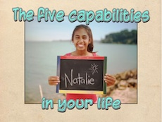
The five capabilities in your life
Use: to get students thinking about their lives and how the capabilities fit into it. The presentation specifically shows elements of two young people’s lives, and provides a commentary, pointing out how these experiences could be used as examples of the five capabilities.
It is not expected that students work through all of the activity 1 presentations, this may well be overkill!

Slide 55
Identifying goals

Slide 56
Activities
Formative
Summative
Students complete the “My profile” interactive PDF to help them:
Identify their values
Identify goals for the future
Purposefully seek advice from others
Students complete a plan which:
Identifies a pathway to post school employment
Identifies a study and/or training pathway.
Documents the advice given to them by relevant people

Slide 57
Formative: My Profile
Students download and save a My Profile interactive PDF. It’s purpose is to help students to identify a post school employment pathway based on their values. It is a formative activity, in which they will select images, input text or audio comments.
Each chapter of the interactive PDF has a corresponding presentation. The presentations have been made so that teachers can model the process of filling in the PDF to the class.
Originally I had hoped to include all the slides in just the interactive PDF, with the supporting audio recording of text, interactivity, user text fields etc. This was problematic as this made the interactive PDF too large a file.
As a result, the supporting slides have been relegated to the presentations, and the slides which students alter are in the PDF.

Slide 58
Setting goals
Purpose: To introduce the concept of goal setting in an employment context .
Use: a basic presentation which can be used to look at how planning and goal setting helps to achieve long term goals

Slide 59
What are values?
Purpose: To look at the consequences of making life decisions based on your values, and the conflicts this sometimes causes
Use: You can go through one or both of the scenarios with students. The first scenario can be used to exemplify how making decisions that ignore some of your values can cause tension, and then with the second scenario, ask students to predict the consequences of each decision before watching the rest of the presentation.

Slide 60
What is important to you?
Purpose: Assist students to identify two values.
Use: Students work on the first chapter of the My Profile interactive PDF. They select two images from the options in the chapter, which represent two values. They write or record a brief explanation for each value selected, explaining why each is important to them. Teachers can model the process of selecting and discussing why the values have been selected using the ‘Identifying values’ presentation.

Slide 61
What is your dream for the future?
Purpose: Designed to assist students to identify the kind of lifestyle they would like to have when they leave school.
Use: Students select one image that describes where they would like to live, the pace of life they would enjoy and who they would like to share their life with. They write or record a brief explanation of why they have made these choices. The teacher can use the Dream for the Future presentation to model the selection and explanation process.

Slide 62
What is your personality?
Purpose: Designed to assist students to identify their perception of themselves
Use: Students select three images which represent aspects of their personality. They write or record a brief explanation of their answers. Teachers use the “What is your personality” presentation to model image selection and explanation process.

Slide 63
Who will help me?
Purpose: Introduces and unpacks the expectation of contacting relevant people for help and advice to successfully complete PLP
Use: The presentation can be completed in sections, or in one/several consecutive sessions. The focus is on identifying the types of people who would be accessed for advice (skip those not relevant i.e. if no career advisor) and look at the ways you can make contact and document this interaction.
Can get students to begin establishing contact with relevant people to start helping them to make links between the life they have identified they want and possible jobs they might like to have.
Otherwise can introduce the concept of seeking help and recording attempts, to be completed by students in the next presentation.

Slide 64
Deciding on a pathway to the future
Purpose: To assist students to identify possible jobs that might suit their student profile.
Use: Presentation outlines a process for students to identify suitable jobs. There are lists of jobs grouped by personality/interests as well as videos that contain interviews with indigenous people employed in these industries for students to watch if they like.
Presentation can be used to model the job identification process.
The students selections so far have all been collated on the one page, to give them a mood board/global overview/snapshot of what is important to them. This should be used as a springboard for students to help identify the jobs that may suit them. This could also be used with those people whom students seek advice.

Slide 65
Your top 2 jobs
Purpose: Designed to assist students to narrow the identified possible jobs down to their top 2.
Use: Presentation can be used to demonstrate the narrowing down process. Students can also consult with others (family, teachers, career consultants) to help with the narrowing down process.

Slide 66
Pathways to the future
Purpose: Helps teachers and students understand the different pathways from school to work/training/uni.
Non linear format: This presentation should not be used in its entirety. It would be an incredibly overwhelming and confusing experience to try to look at every pathway. It is advised that teachers select the most likely pathways (most local students are going into work or training or uni) and support student progress through exploration of a few chosen pathways.
Use: Gives a general overview of some of the pathways students can take from school to training/employment. Should be used to familiarise students with some of the pathways, which they will then investigate further, looking at the specific pathway they would need to take to get the job they have chosen. This can be done with the assistance of one of the support people they have contacted.

Slide 67
Pathways at school
Purpose: To provide pathway information about a range of jobs. This guide is not exhaustive, we could only cover a range of jobs, so using Myfuture or other sites is recommended as well
Non linear format: Students can investigate the pathway that interests them.
Use: This can be used early in the second unit, as a means to help students select a job they like, and then again when they need to identify a pathway to the job.

Slide 68
Assessment
Activity

Slide 69
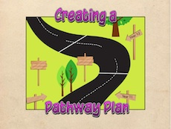
Creating a Pathway Plan
Purpose: To provide a detailed explanation of the ways students can create their Pathway Plan
Non linear format: Students can investigate the ways they can create a pathway plan via a few different options (VET, getting Year 12 etc.).
Use: This can be used in short segments, where students look at one part of the presentation, then complete their own part of their pathway plan, then watch the next bit of the presentation etc. OR it can be presented as a whole to them. The second option is not recommended unless working with very capable students.
This presentation can be used in conjunction with the sample activities as exemplars.

Slide 70
Model Pathway Plan
Purpose: Designed to give students a model example of the Pathway Plan activity to consult
Use: Plan can be unpacked as a class, to identify how the information has been displayed and the kinds of information/language used, to assist students understanding of the requirements.

Slide 71
Developing Capabilities

Slide 72
Activities
Summative
In this activities, students:
Identify a skill or skills they would like to develop
Set themselves some short term goals that will help them to achieve their long term employment goal
Seek advice from relevant people to help them to identify and refine goals
Develop strategies to implement their goals
Document their process in trying to achieve their goals

Slide 73
Developing personal and learning goals
Purpose: To demonstrate how to identify a skill and create goals in response to it.
Non-linear format: The presentation takes the viewer through Mike’s journey, choosing to develop work skills. If you would like to show students other options (at least one other option would be advised) the grid menu allows the user to look at each of the four remaining capabilities. Teachers might take students through work and one other skill (or two other skills if you don’t want to cover work) and then allow students to look through the other skills of their choice.
Use: The presentation models the character Mike identifying some goals in response to each of the five capabilities. His post school goal remains the same, but he is able to develop all of the capabilities in response to this.
Students obviously do not need to do the same and try to develop all of the capabilities. One or more are recommended. The model looks at all the capabilities to help students think of the different ways capabilities can be developed to meet a goal.

Slide 74
Developing personal and learning goals (cont.)
Purpose: To demonstrate how to identify a skill and create goals in response to it.
Summative activity:
Students can begin brainstorming identifying short term goals and the skill or skills they could develop
They could begin consulting with relevant people, getting advice about the skill they might develop and the kinds of short term goals they could set

Slide 75
Identifying SMART goals
Purpose: To unpack the process of creating a SMART goals
Use: The presentation models the difference between vague goals and SMART goals. Each section models what it is to be measureable or achievable and what is not measureable etc.
Non-linear format: the SMART process can be looked at in a non-linear fashion, but all sections of the SMART process will need to be covered with students

Slide 76
Identifying SMART goals (cont.)
Purpose: To unpack the process of creating a SMART goals
Formative exercises:
Class constructed SMART goal on the board
Students setting SMART goals for Mike
Identifying which example goals are and aren’t SMART goals and discussing why.
Summative activity:
Students rewrite their goals as SMART goals. They don’t really need to discuss why each goal is a SMART goal, but it may be wise for teachers to check students work and see if they have understood the concept.

Slide 77
Identifying and refining goals
Purpose: To refine goals in response to feedback and reinforce the need to consult with others to be successful in PLP.
Use: The presentation models the way Mike has identified goals and refined his goals in response to teacher and employer feedback.
This topic meshes well with the next one, effective strategies. It might be worth covering the both of them and then asking students to refine goals and devise strategies with their contacts.
Formative exercises:
Class collaboratively refines a goal on the board
Summative activity:
Students can seek advice and record this in some way
Students begin to refine and tweak their goals in response to feedback (this may need to be facilitated).

Slide 78
Developing strategies to achieve your goals
Purpose: To unpack the process of identifying strategies to achieve goals
Use: The presentation models the way Mike has identified strategies to achieve his goals in response to teacher and employer feedback.
This topic meshes well with the previous. It might be worth covering the both of them and then asking students to refine goals and devise strategies with their contacts.
Formative exercises:
Class brainstorms strategies they could use to achieve a model goal
Summative activity:
Students can seek advice and record this in some way
Students develop a range of strategies, then refine the list in terms of which are achievable and useful.

Slide 79
Activity

Slide 80
Achieving your goals
Purpose: To model the ways students can record their process in trying to implement goals
Non-linear format: Students and teachers can access the different formats through the grid menu. There will be formats in this presentation that teachers will not want students to use due to resources limitations etc, these parts of the presentation can be avoided.
Use: The presentation shows a wide range of the ways the same content (Mike trying to implement his goals) can be presented using multimodal activity formats. Tutorials have been included to help teachers and students develop skills in using different multimodal formats.
Summative activity:
Students implement their strategies and try to achieve their goals. They record their progress with some form of annotation or explanation of what they did

Slide 81
Reflection and evaluation

Slide 82
Activity
Summative
In this activity, students reflect on:
The success of their attempt to achieve their goals
The usefulness of the strategies they used
How they chose to develop the selected capabilities and if this helped them to achieve their goals

Slide 83
What is a reflection?
Purpose: To provide examples of the kinds of language and content in a reflection
Use: The presentation compares a recount and a reflection text that describes the same event. Some unpacking of how the language and content differs is covered. This will require further unpacking and modelling by teachers.
Formative activity:

Slide 84
Assessment
Activity

Slide 85
Your reflection
Purpose: To model the way students can create a reflection.
Use: The presentation contains a model of Mike’s reflection. It highlights the kinds of language used.
Summative exercises:
Create separate word banks of the terms used when recounting and used when reflecting
Create a shared text on the board where class members recount an event and then reflect on it and identify the differences

